Slide 1
DecAide: The Virtual Fashion Historian
APCOMP 215
By Tom Zhou, Sophie Thorpe, Paige Lee, & Josha Thomas
Notes:
Sophie

Slide 2
TABLE OF CONTENTS
01
02
03
04
Problem Statement
Unique Value
Scalability
Future Development
Notes:
Sophie (just show this no need to explain)

Slide 3
Problem Statement
It’s challenging to visually distinguish clothing from different time periods due to recurring fashion trends.
This is especially true for looks that are less commonly seen in the general public, like high fashion attire.
Notes:
Tom

Slide 4

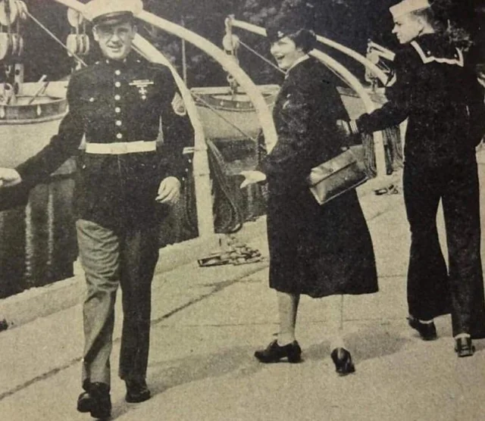
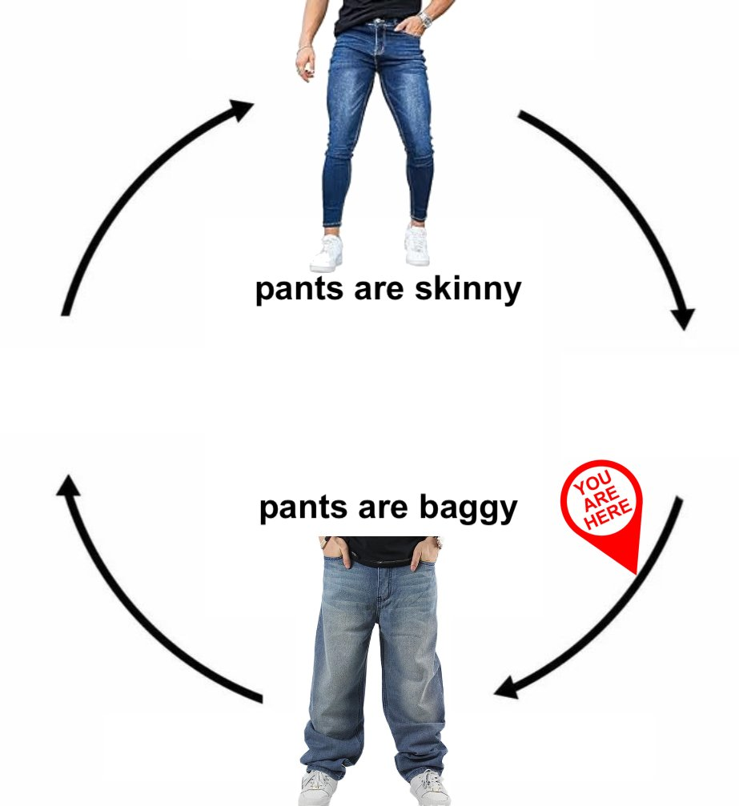
Notes:
Tom

Slide 5
The DecAide Model
Data Source:
Scraped ~6000 runway images from 150 shows (1988-2015) on vogue.com using BeautifulSoup and Requests-HTML.
Model Architecture:
Loaded and preprocessed data from the bucket, encoded year labels, removed duplicates, and created a TensorFlow Dataset using standardized tensors.
Used transfer learning with ResNet50, added layers, unfroze the last ten layers, and trained the model using categorical cross-entropy, Adam optimizer, accuracy as our metric, and we trained for 30 epochs.
Notes:
Tom/Sophie

Slide 6
Target Audience
We are designing a tool for celebrity stylists, people who need an efficient way to understand historical fashion references to style their clients using clothing featured on high fashion runways.
Notes:
Josha

Slide 7
Unique Value
When a stylist needs to reference an era of fashion quickly for a client, they may rely on historical archives which can be time-consuming to sift through especially with niche themes.
Our tool can expedite the process by streamlining how stylists access fashion references.
Notes:
Josha

Slide 8
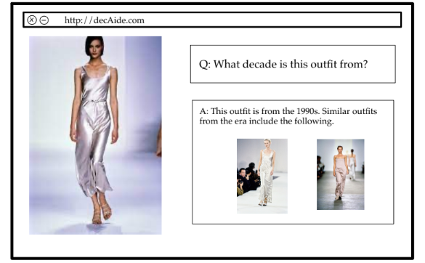
Case Study
Notes:
Josha

Slide 9
Case Study: The Met Gala
What is the Met Gala?: A high-profile annual fundraising event for the Costume Institute Metropolitan Museum of Art in New York City.
Purpose: Raises money for the museum and celebrates the opening of the institute's annual fashion exhibit.
Attendees: Celebrities who wear extravagant outfits based on a specific theme.
Theme: Each year, the Met Gala has a theme that reflects the exhibit.
The theme in 2022, “In America: An Anthology of Fashion” explored American designs from the 19th to the mid-late 20th century. As a stylist, you want to quickly reference influential pieces from that time period to suit the theme.
Notes:
Josha

Slide 10
Scalability & Efficiency
Technical Scalability: Since our application uses Docker containers to run the model and google cloud platform to store the data, we will be able to deploy our application.
Optimization: The model achieved over 90% accuracy despite the large number of categories and small dataset. We plan to fine-tune the model using data augmentation, SMOTE to address class imbalance, and further hyperparameter adjustments to handle distribution shifts.
Infrastructure: We are using Docker containers, Google Cloud Platform, and Google Colab to complete our project.
Notes:
Tom/Sophie

Slide 11
Future Development & Growth Potential
Next Steps: Our next step is to deploy our web app using the credits we have been afforded by the class.
Market Growth: Our model could be expanded to describe the features of the images it categorizes as similar and present that to the user.
Notes:
Paige

Slide 12
Thank You!
Any questions?
Notes:
Paige

